Slide 1
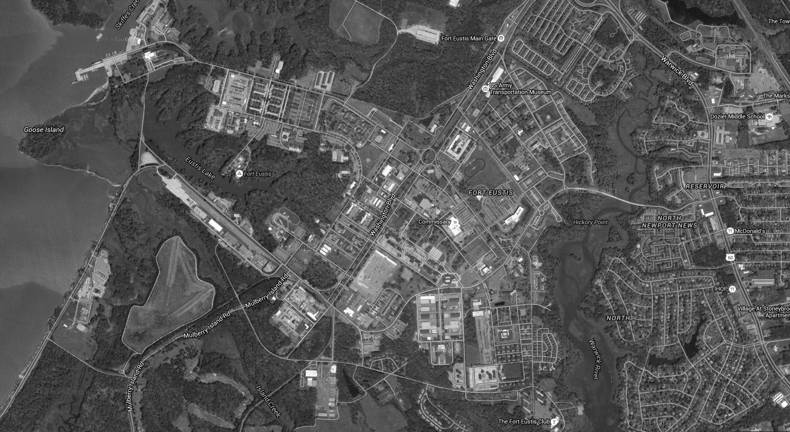
FORT EUSTIS FACILITY MANAGER PROGRAM

Slide 2
TABLE OF CONTENTS
Module 1 - Facility Manager Responsibilities
Module 2 - How Work Gets Done
Module 3 - Operations Flight
Module 4 - Energy Management

Slide 3
OVERVIEW
733 Civil Engineer Squadron’s mission is to provide fire protection, emergency response, facilities engineering and operations support, infrastructure & real property management, comprehensive land use planning, environmental and housing management for JBLE-Fort Eustis
AFI 32-1001 Operations Management: Requires CE Squadrons to execute and manage a Facility Manager program to standardize guidance and streamline processes to improve customer service and mission execution

Slide 4
733D CIVIL ENGINEER SQUADRON

Slide 5
MODULE 1 FACILITY MANAGER RESPONSIBILITIES

Slide 6
FACILITY MANAGER (FM) APPOINTMENT PROCESS
Must be appointed by unit commander (Battalion or Deputy Brigade level)
Must be E-5+ or above; Civilian equivalent
Must submit a new appointment letter signed by commander at least 30 days prior to deployment, retirement, or separation of assigned FM
Letter must have at least two contact numbers for FMs
Commanders may appoint only one primary and up to two alternate FMs
Commanders may appoint FM or other person, such as Collateral Duty Safety Officer to be Activity Environmental Coordinator (additional duty) as well. This additional duty is not insignificant and should be assigned in light of FM workload

Slide 7
AFI 32-1001
FMs who fail to complete training will not be authorized to initiate work requests or place non-emergency service requests
Ensure you stay current on the annual requirement for FM training and appointment letters
POC Danielle Quinlan, 878-2489; Chris Nye, 878-4134
The unit commander will ensure all alterations, additions or new construction to facilities are done with CE approval
CE approves all work in real property facilities, regardless of contract method or funding source. (E.g. site approvals, technical approvals, customer funded etc.)

Slide 8
BUILDING POC DELEGATION
Many Facility Managers are responsible for multiple facilities
Commanders or Appointed Facility Managers are to select a POC from each facility they are responsible for
The POCs are responsible for placing Service Requests and notifying the Facility Manager of Work Request (AF Form 332) requirements
Building POCs MUST notify Facility Managers of all Service Requests placed
Commanders or Appointed Facility Managers must notify 733 CES when Building POCs change
Try to pick POCs that will be relatively long-term

Slide 9
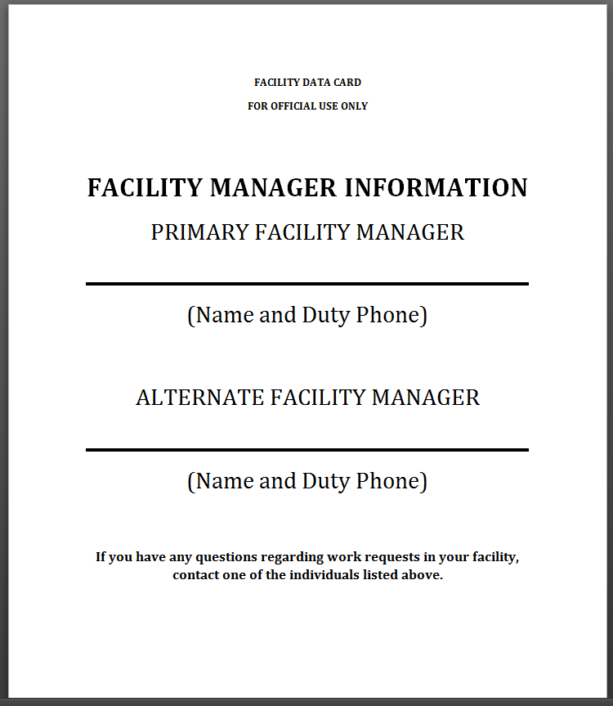
FACILITY MANAGER DATA CARD
Ensures occupants know who their FMs are
Post on ground/each floor of each facility by major entrances.
Available on CE Webpage:
https://www.jble.af.mil/Units/Army/733D-Civil-Engineer-Division/

Slide 10
FACILITY MANAGER RESPONSIBILITIES
Provide detailed descriptions of work requirements to Operations Flight (332s) or Customer Service Desk (Service Requests [SRs])
Vague or incomplete 332s will be returned
Keep a log book of all Work Requests (332s, 813s & Service Requests)
Prevent duplicate requests
Keep copies of all AF Form 332s/813s submitted
Keep Commanders and leadership informed of progress of work orders & SRs
The Base Civil Engineer (BCE) should not be the first CES POC contacted
Ensure building occupants know who the FM is and how to contact you with work requirements

Slide 11
FACILITY MANAGER RESPONSIBILITIES
Hurricanes and Other Inclement Weather
Before event, secure all loose objects outdoors or bring inside if possible
Move GOVs and POVs away from large trees or possible flying debris
If building is subject to flooding, or has a basement, move assets to upper floors or elevate if possible
Secure all facilities (windows and doors) upon leaving and cover sensitive equipment that may be damaged by intruding water
After inclement weather (e.g. wind, hurricane), ensure a visual inspection of facilities for incident damage (tree/wind damage) is completed in a timely and safe manner
Including when installation is operating under limited conditions, OR if installation is open on weekends
Report all damage and outages to CES at 878-5225/4357. Call 9-1-1 if it is an emergency
Email photos of damage to 733MSG.733CES.WorkOrderRequests@us.af.mil

Slide 12
FACILITY MANAGER RESPONSIBILITIES
Snow & Cold Weather
Before event, make sure heat is operational, and faucets are on a drip if applicable
Consolidate GOVs in one corner of parking lot for plowing
Removal of snow/ice from entrance ways & sidewalks (300’ radius)
Sand and Salt will be stockpiled in the CES compound and available for pickup upon notification
BYOB – Bring your own Bucket, Shovel, and GOV…No truckloads, No dump trucks
After inclement weather, ensure a visual inspection of facilities for damage (frozen pipes, leaks, tree/wind damage) is completed in a timely and safe manner
Including when installation is operating under limited conditions, OR if installation is open on weekends
JBLE Snow/Ice Removal Plan is available at https://www.jble.af.mil/Units/Army/733D-Civil-Engineer-Division/

Slide 13
MODULE 2
HOW WORK GETS DONE

Slide 14
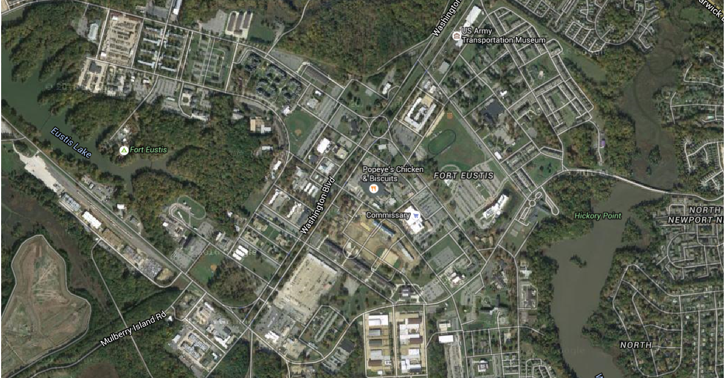
733 CES BUILDING 1407 Location

Slide 15
BASE OPERATION SUPPORT (BOS) SERVICES
Instead of Shops, JBLE-Eustis has a BOS Contractor
BOS Contract incorporates all shop functions for CES and executes the following:
Preventative maintenance on facility equipment
Pesticide application, severe weather response, service requests
Generator operations and maintenance
Swimming pool maintenance
BOS does not handle paint work more than 200 SF. Paint work more than 200 SF is handled through the Paint IDIQ Contract
Contracting Officer Representative (COR) for BOS –
Desiree McHan, 878-7369, desiree.mchan@us.af.mil
Morton Manning (on board June 2022)

Slide 16
WORK REQUEST CATEGORIES
Recurring Work (Preventative Maintenance)
Service Requests
Work Orders
Operations Projects
Projects (Engineering)

Slide 17
WORK REQUEST CATEGORIES
Recurring Work (Preventative Maintenance)
Scope and level of effort is predetermined
All recurring work necessary to prevent breakdown of critical facilities, equipment, or utilities
Examples Include - Storm drain cleaning, BMP maintenance, elevator inspection, replacing filters, generator testing

Slide 18
SERVICE ORDERS
FMs & Building POCs may submit Service Requests by calling, emailing, or visiting building 1407, room 105
Record Service Request number to facilitate follow-up and ensure completion
ALWAYS CALL 9-1-1 FOR EMERGENCIES
ANYONE may place EMERGENCY Service Orders - Please make sure all building occupants know the building number
Customer Service Desk - 878-5225 / 878-4357
Hours of Operation: Mon-Fri, 0700-1700
Emergency After-Hours - 878-5225/4357 - redirects to Fire Dispatch
Email Service Orders:
733MG.733CES.WorkOrderRequests@us.af.mil
Do Not Share with non FMs/POCs
Include all relevant information: Bldg, POC name/number, Detailed Description, etc
DO NOT email Service Requests for emergency/urgent matters

Slide 19
WORK REQUEST CATEGORIES
Service Request (SR) Priorities
Priority 1- Emergency SR
30 min after being notified / 2 hours during non-business days
Repair work will continue until condition has been corrected or stabilized
Examples – leaking roof with ongoing damage, refrigerator breakdown at DFAC, no A/C or heat in the building (not individual offices) etc.
Priority 3A (High) – Scheduled Sustainment Work (High)
Work scheduled within 2 business days of request, 5 business days to completion
Corrective maintenance projects with a high return of investment (ROI)
If work cannot be completed in timeframe COR will be notified for extension
Examples – Perimeter fencing, street lighting at intersection, repair Exterior Security Lights

Slide 20
WORK REQUEST CATEGORIES
Service Request (SR) Priorities (cont’d)
Priority 3B Medium – Time sensitive corrective maintenance work
Work scheduled within 5 business days of receipt, 30 day completion
Examples: Ceiling tile replacement, changing broken fixtures and door handles, etc
Priority 3C Low – Corrective maintenance work
Work scheduled within 5 business days of receipt, 30 day completion
Examples: Installation of informational signs, tree limb removal, etc
.

Slide 21
REIMBURSABLE BOS CONTRACT PROJECTS
The BOS contract has a limited monetary capacity to execute reimbursable work larger than the scope of Service Requests
Reimbursable projects that do not receive funding within 45 days of the initial request for funding will be placed on hold
Projects which have a defined and firm Statement of Work (SOW) with funding in hand will be prioritized ahead of projects without

Slide 22
Module 3 OPERATIONS FLIGHT

Slide 23
”BIG THREE” SERVICE CONTRACTS
CUSTODIAL
REFUSE
GROUNDS MAINTENANCE
Facility Managers report potential deficiencies to contract CORs

Slide 24
CUSTODIAL
Primary COR – Michael Franceschini, 878-7385 - michael.franceschini.3@us.af.mil
Alternate – Tom Gunther, 878-1387- thomas.gunther@us.af.mil
Restroom cleaning only
1st Week Monday – Wednesday – Friday
2nd Week Tuesday – Thursday
Paper and soap products for restroom use only
Customer must supply trash bags
Each building needs a centralized location to place trash for collection
No more desk-side trash collection
Contact COR for information on obtaining custodial services
Additional Services available for Non-Air Force units with customer reimbursement
Vacuuming, sweeping, mopping, dusting, carpet shampooing, hard floor buffing/waxing

Slide 25
REFUSE/RECYCLING
COR Tom Gunther –757-449-4748 - thomas.gunther@us.af.mil
Alternate – Janice McGhee, 878-5466 - janice.mcghee@us.af.mil
Single Stream recycling pickup Tuesday- place containers out Monday night
Drivers start at 0400
Cardboard containers are serviced Tuesday and/or Friday
You can bring cardboard to the recycle center where it is crushed and baled
Place shredded paper in clear plastic bags by recycle containers
Do not shred CDs, Credit cards, plastic coated paper or envelopes with the clear plastic window
Open top containers provided upon request if funding is available
Requestor can provide funding. Containers not to be used to dispose of furniture, TVs, or construction debris
Toner will not be picked up if in or on top of recycle containers
All toner cartridges must be placed in the box the replacement came in/clear plastic bag & taken to recycling center

Slide 26
REFUSE/RECYCLING (cont’d)
Please deliver large items to the recycling center or contact CE for assistance
Normal Operating Hours: 0730-1500, M-W-F, B1209
Recycle used oil, oil filters & empty oil cans at the recycle center
Recycle has a commercial shredder and a classified & higher class shredder
Call for appointment at 878-4232
NOT recyclable - Oil cans, paint buckets, aerosol cans, and other chemical containers
They should be taken to the Haz Waste Storage Facility B 1207/8

Slide 27

GROUNDS MAINTENANCE
COR Janice McGhee – 757-298-0865 - janice.mcghee@us.af.mil
Alternate - Michael Franceschini, 878-7385 - michael.franceschini.3@us.af.mil
Lawn maintenance
Vegetation height maintained varies
Improved Grounds – 2”-4” (includes edging)
Semi-improved Grounds (Non-Airfield) – 4”-10”
BASH Area – 7”-14”
Edge lights and Signs – 15’ diameter 4”-7”
Growing Season is March-October

Slide 28
SERVICE CONTRACTS ( Railroad, Elevator, Crane and Hoist Services)
Railroad Services –
Primary: Michael Franceschini, 878-7385 - michael.franceschini.3@us.af.mil
Alternate: Tom Gunther –757-449-4748 - thomas.gunther@us.af.mil
Maintains all tracks and crossing signals
Pesticides application on tracks
Elevator Services –
Primary: Janice McGhee, 757-298-0865 - janice.mcghee@us.af.mil
Alt: Michael Franceschini, 878-7385 - michael.franceschini.3@us.af.mil
Maintenance of the elevators on post
Executes routine inspection and certification
Note: if entrapment occurs in an elevator call 9-1-1
Crane and Hoist Services –
Primary: Janice McGhee, 757-298-0865 - janice.mcghee@us.af.mil
Alt: Tom Gunther –757-449-4748 - thomas.gunther@us.af.mil
Maintains all Cranes and Hoists with exception of the Hagglund Crane at the Army Transportation School
Execute routine inspection and certification

Slide 29
WORK ORDERS
AF FORM 332
Minor construction, major maintenance/repair or new work that requires detailed planning or modification of facility
Definition of these categories is not always intuitive
Initiates Work Orders, Projects, or Contract by Requester with Technical Approval
Facility Manager must sign AF Form 332
It is extremely beneficial to have your organization’s Top 10 Priorities ready to provide to CES when requested

Slide 30
WORK REQUEST CATEGORIES
Work Orders
FM must submit AF Form 332
Project-oriented work such as modifications, total replacements and new work that are beyond the Service Order criteria
Work Orders can vary significantly in nature and scope and may involve multiple crafts and locations
Significant investment of time, labor, or money
Accomplished through various contracts (see Engineering Project Contracting Avenues slide)
Contract by Requester
Facility Managers must also submit AF Form 332 to accomplish work themselves
Contract by requester or Self Help
These requests require Technical Approval by CES
Customer GPC used to accomplish work

Slide 31
WORK REQUEST MANAGEMENT (AF FORM 332)
Submit to: danielle.quinlan@us.af.mil
Alternate: christopher.nye@us.af.mil
Provide detailed Description & Justification
Attach any pertinent safety write-ups, photos, area maps, drawings, designs, sketches
Vague or incomplete AF Form 332s will be returned

Slide 32
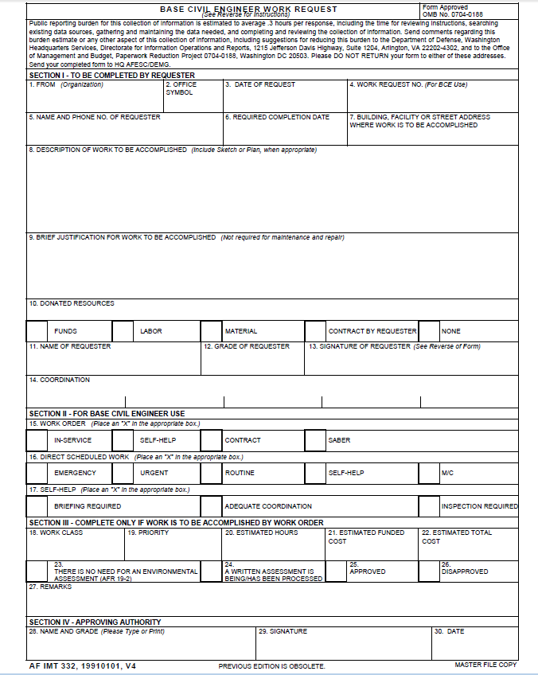
AF FORM 332 SAMPLE
Section I: To be completed by FM – See next slide
Section II: To be completed by 733 CES.

Slide 33
AF FORM 332 SAMPLE
PROVIDE OFFICE SYMBOL
DATE WORK WAS REQUESTED
IWIMS TRACKING/NUMBER ASSIGNED AFTER WRRB (CES USE ONLY)
ORGANIZATION NAME
REQUESTOR’S NAME & PHONE #
FACILITY NUMBER
DESCRIPTION
JUSTIFICATION OF WORK
DONATED RESOURCES CHECK ANY BOX THAT APPLY
BLOCKS 11-13
FACILITY MANAGER
It is the Customer/Facility Manager’s responsibility to complete Section I before sending to CES

Slide 34

WORK REQUEST PROCESS
332s are routed through Flights and then to the Work Request Work Group (WRWG) for final review/approval/disapproval (allow at least 14 days)
Operations, Engineering, Environmental, Fire Dept, Asset Management
Submit 332
Flight Reviews
Funding
Begin Work

Slide 35

WORK REQUEST WORK GROUP (WRWG)
FMs will be notified when a project they requested is being reviewed
CEO & CEN review 332 requests and determine execution method

Slide 36
POCs
Service Order Desk, 1407 Washington Blvd
Mon-Fri, 0700-1700
878-5225 / 878-4357
After Hours – phones automatically forward to Fire Dispatch
Work Request Management
SUBMIT AF Form 332 to…
christopher.nye@us.af.mil – 878-4134
*and*
danielle.quinlan@us.af.mil - 878-2489

Slide 37
Module 4 ENERGY MANAGEMENT

Slide 38
ENERGY MANAGEMENT PLAN
Reduce Facility Energy Use 2.5% per year to 2025 (Baseline 2015)
Reduce Base Water Use 2% per year to 2025 (Baseline 2007)
25% of total energy (electric and thermal) will come from clean sources by 2025 (at least 30% of the electricity portion of total energy will be obtained from renewable sources)
Reduce Ground Vehicle fuel use 2% per year
Increase Alternative Fuel use 10% per year
Executive Order 13834 revokes Executive Order 13693 but using guideline until new goals are established

Slide 39
ENERGY MANAGEMENT (Energy Conservation)
Cost of utilities required to operate Ft. Eustis for ONE day.
Utilities - $33,403.19
Natural Gas $4,636.98
Electricity - $21,403.76
Fuel Oil - $148.11
Propane - $45.47
Water and Wastewater - $7,168.85
Total FY 18 Utility Bill - $12,025,151.73
Total FY 17 Utility Bill - $11,591,955.68

Slide 40
HVAC SET POINTS
Heating:
Heating turned on when average high air temperature drops to 55 °F for 4 consecutive days
Thermostat Set Points:
Admin Spaces: Occupied – 70 °F // Unoccupied: 55 °F
Shop Spaces: Occupied - 65 °F // Unoccupied 55 °F
Warehouse Spaces: Occupied - 60 °F // Unoccupied 55 °F
Cooling:
AC turned on when average high air temperature reaches 75 °F for 4 consecutive days
Thermostat Set Points:
Admin Spaces: Occupied – 73 °F // Unoccupied - 80 °F
Shop Spaces: Occupied - 76 °F // Unoccupied – 80 °F
Warehouse Spaces: Not required unless authorized for perishable items

Slide 41
ENERGY MANAGEMENT (Energy Conservation Plan)
Consolidate refrigerators and coffee pots to central break areas
No space heaters unless approved by CE Operations for legitimate health reason
Turn off lights in unoccupied spaces
Turn off computer monitors and peripherals at end of duty day
Turn off printers, copiers, scanners and other office equipment at end of duty day
Dress appropriately for personal comfort
Establish, maintain and maximize use of Energy Management Systems (EMCS, SCADA, etc.) to centrally monitor and control utility and building systems
Prohibit use of potable water for landscape irrigation systems

Slide 42
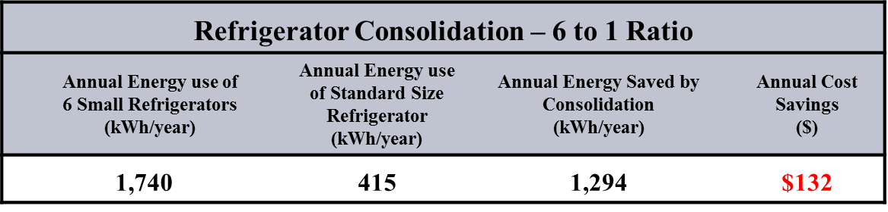
ENERGY MANAGEMENT (Energy Conservation Plan- contd.)
REFRIGERATORS
Reduce the number of personal refrigerators, coffee makers and microwaves in facilities and consolidate appliances in designated break areas. Validate the necessity of every refrigerator, coffee maker and microwave and consolidate break areas to the maximum extent possible

Slide 43
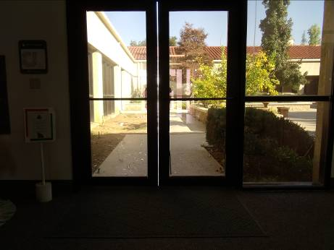
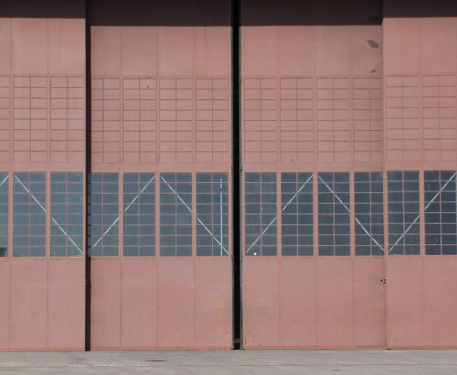
ENERGY MANAGEMENT (Envelope Opportunities)
Close Doors
Fix weather-stripping

Slide 44
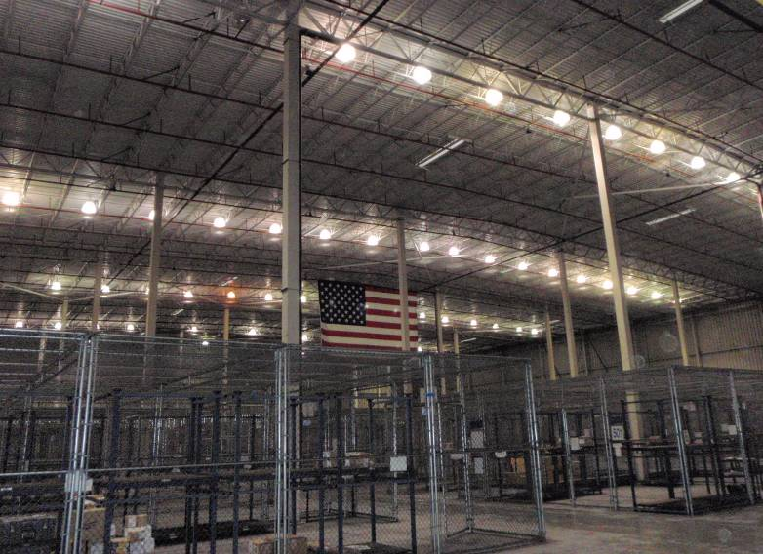
Lights are on, but nobody is home

Slide 45
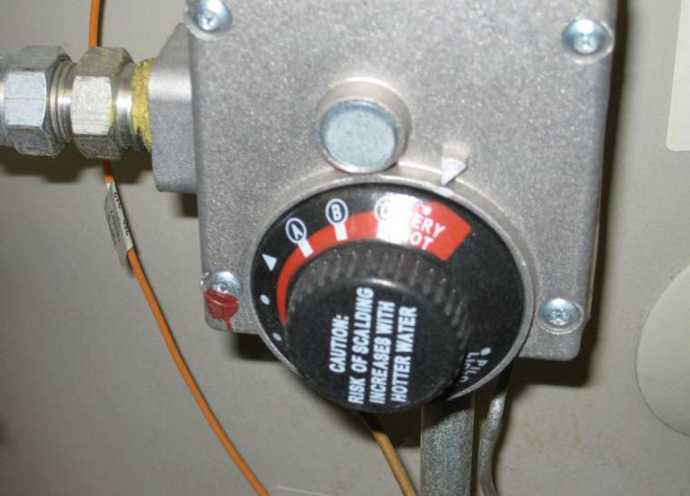
Do you need very hot?
Building occupants should not tamper with water heaters
FMs can place a service order to have their water heaters turned down

Slide 46
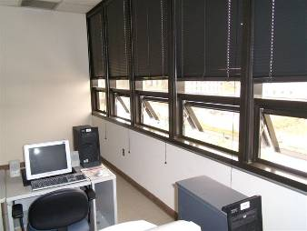
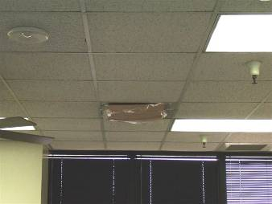
Do Not…
Block air diffusers
Open windows, exterior doors
Invitation for MOLD

